Slide 1
BRITISH AIRWAYS
Web Scraping

Slide 2
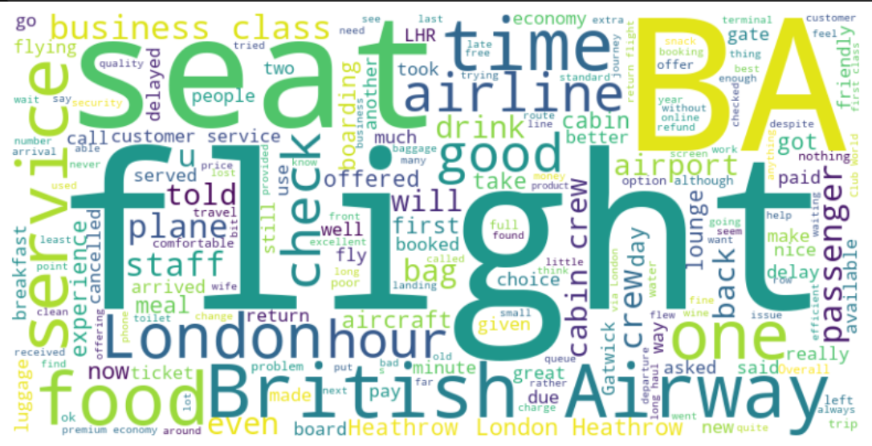
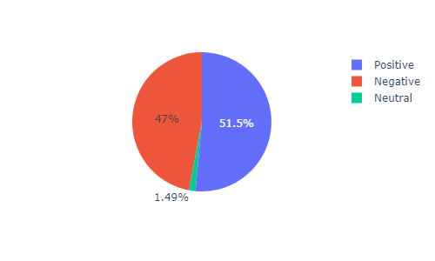
Topic Modeling
Topic 1: flight ba food service crew seat class cabin good london seats business time economy british
Topic 2: flight ba london british airways service told hours customer check staff time airport heathrow did
WordCloud
Review Analysis

